Slide 1





The B.C. Graduation Program
Grades 10-12
March 28, 2018
Burnaby BC

Slide 2

Continuing on the Journey of
Transforming Education in BC

Slide 3



2
Presentation Overview
Policy for Student Success
Why Now?
Grade 10-12 Curriculum Overview
Implementation Schedule
Provincial Assessments
Reporting Graduation Assessment Results
Career Curriculum
Post Secondary Update
Resources & Support

Slide 4

Policy for Student Success
Our students' success is based on a simple vision:
.
Capable young people thriving in a rapidly changing world
  B.C. is dedicated to maintaining its position as a global leader in education by pioneering systemic changes that prepare students for a rapidly changing world . To achieve this, we need an education system that better engages students in their own learning and fosters the skills and competencies they will need to succeed.

Slide 5
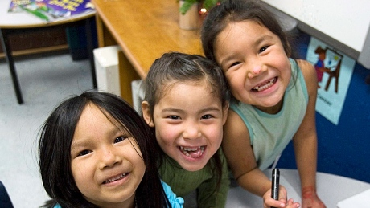

2
Our Mandate – the Educated Citizen
As specified in the Statement of Education Policy Order, the purpose of our school system is to enable learners to develop their individual potential and to acquire the knowledge, skills and attitudes needed to contribute to a healthy sociality and a prosperous and sustainable economy.
    Developing the Educated Citizen requires …
    Intellectual Development
    Human and Social Development
    Career Development
Notes:
As specified in the Statement of Education Policy Order, the purpose of the British Columbia school system is to enable learners to develop their individual potential and to acquire the knowledge, skills and attitudes needed to contribute to a healthy society and a prosperous and sustainable economy.
Statement of Education Policy Order (Mandate for the School System) . Anthony J. Brummet Minister of Education Province of British Columbia Vancouver, British Columbia September 1, 1989

Slide 6
The Educated Citizen
Thoughtful, able to learn and to think critically, and who can communicate information from a broad knowledge base;
Creative, flexible, self-motivated and who have a positive self image;
Capable of making independent decisions;
Skilled and who can contribute to society generally, including the world of work;
Productive, who gain satisfaction through achievement ,and who strive for physical well-being;
Cooperative, principled and respectful of others regardless of differences;
Aware of the rights and prepared to exercise the responsibilities of an individual within the family, the community, Canada, and the world.
Notes:
These attributes of an Educated Citizen—first articulated in the Statement of Education Policy Order (Mandate for the School System) .
Honourable Anthony J. Brummet Minister of Education - September 1, 1989

Slide 7
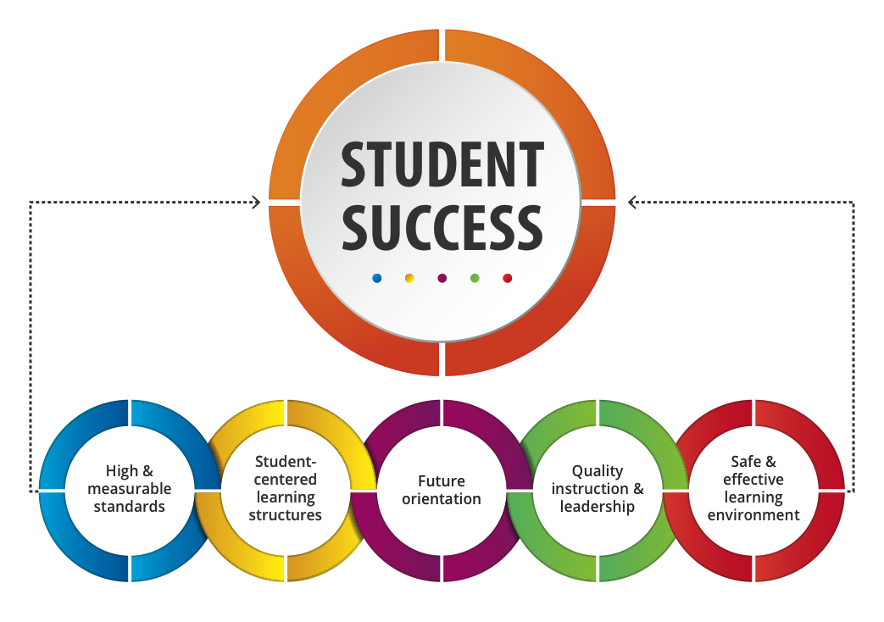
British Columbia’s Policy for Student Success
Notes:
British Columbia’s Policy for Student Success

Slide 8


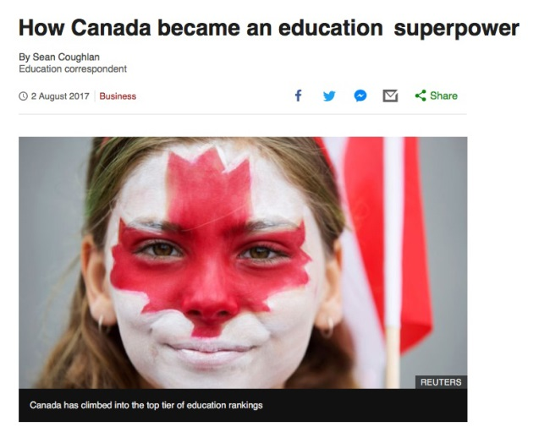
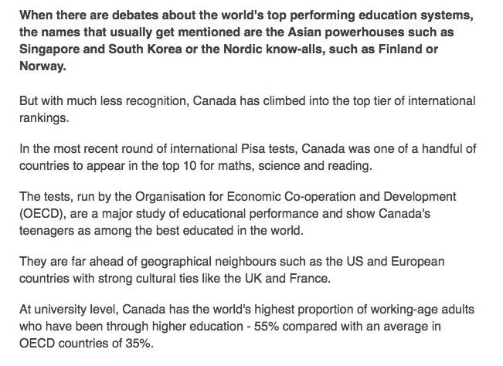
Education Superpower
Canada – top 10
BC – top 5
Higher Education proportion
(55% vs 35%)
Theme of Equity
Fairness and equal access
Immigrant achievement
Narrow socio-economic gaps
Teaching – selective entry, well paid
Literacy – systemic efforts to identify schools and support individuals who require support

Slide 9
SO WHY TRANSFORM NOW?

Slide 10
Exponential Acceleration of Change
Notes:
What has Changed is the Exponential Acceleration of Change
Volker Hirsch
Ray Kurzweil
Moore's Law
Peter Diamandis
Thomas Friedman – Thank you for Being Late
Alec Ross –The Industries of the Future
Adam Grant - Originals
The Second Machine Age – Eric Brynjolfsson – Andrew McAfee

Slide 11
“We stand on the brink of a technological revolution that will fundamentally alter the way we live, work, and relate to one another.
In its scale, scope, and complexity, the transformation will be unlike anything humankind has experience before.”
-World Economic Forum, 2016

Slide 12
  Number of internet devices:
                1984 = 1 thousand
                1992 = 1 million
                2008 = 1 billion
                2014 = 10 billion
                2018 = 31 billion
                2020 = 50 billion
                2030 = 125 billion

Slide 13
Time for human knowledge to double:
          • 1900 = 100 years
          • 1945 = 25 years
          • 2014 = 13 months
          • 2025 = 25 hours

Slide 14

  There are already more than 1.5 million robots operating worldwide
        • that number is expected to grow to 25 million by 2025
-that is only 7 years away

Slide 15
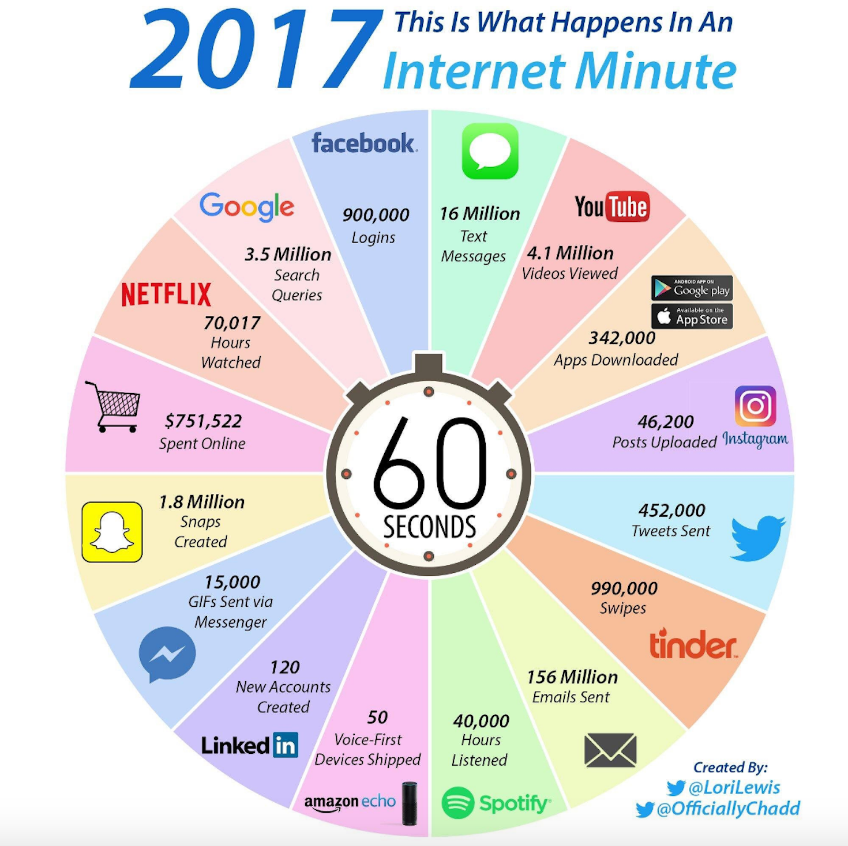

Slide 16
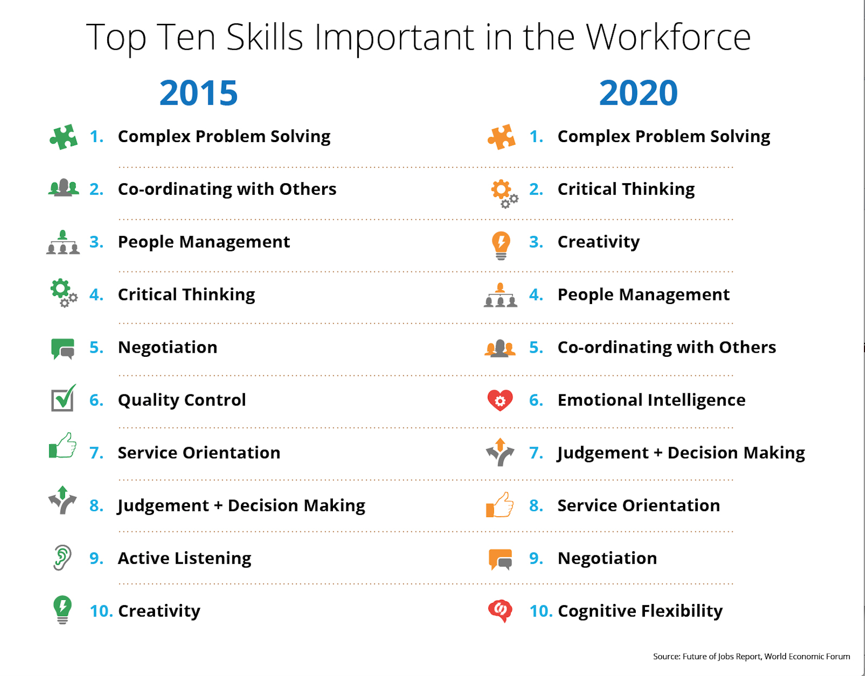
Notes:
Thomas Friedman – Thank you for Being Late
Alec Ross –The Industries of the Future
Adam Grant - Originals
The Second Machine Age – Eric Brynjolfsson – Andrew McAfee

Slide 17
Changing World
In many industries and countries, the most in-demand occupations or specialties did not exist 10 or even five years ago, and the pace of change is set to accelerate. By one popular estimate, 65% of children entering primary school today will ultimately end up working in completely new job types that don’t yet exist.
The Future of Jobs Report p.3

Slide 18
Changing World
On average, by 2020, more than a third of the desired core skill sets of most occupations will be comprised of skills that are not yet considered crucial to the jobs today.
The Future of Jobs Report p. 20

Slide 19
2
Changing World
“For the first time we are preparing students for a future we cannot clearly describe.”
-David Warlick
Notes:
World has a talent shortage problem. Education has been preparing the young people for the wrong economy – it no longer exists. There is a race between education and technology. New technology redefines the value of talent.

Slide 20




2
Old School
COMPLIANCE
[ Collecting dots ]
Transformed School INNOVATION
[ Connecting dots ]
Student Shifts
Passive
Completing
Consuming
Memorizing
Replicating
Isolation
Marching
Rigid
Dependent
Answering
Teacher Centered
Telling
Mass Production
Linear
Presenter
Compliance
Scarcity
Content Experts
Active
Creating, Making
Producing
Processing
Creating
Collaboration
Reflecting
Fluid
Autonomous
Asking
Student Driven
Listening
Mass Customization
Multiple Streams
Facilitator
Divergence
Abundance
Process Experts
The goal of factory schooling was a homogenized, compliant workforce equipped with basic skills produced in
the cheapest,
most efficient
way possible.
The goal of modern schooling is the creation of knowledgeable, adaptable people who can work with others to innovate in the new economy.
Teacher Shifts

Slide 21

Opening Remarks
Grade 10-12 Curriculum Overview and Update

Slide 22
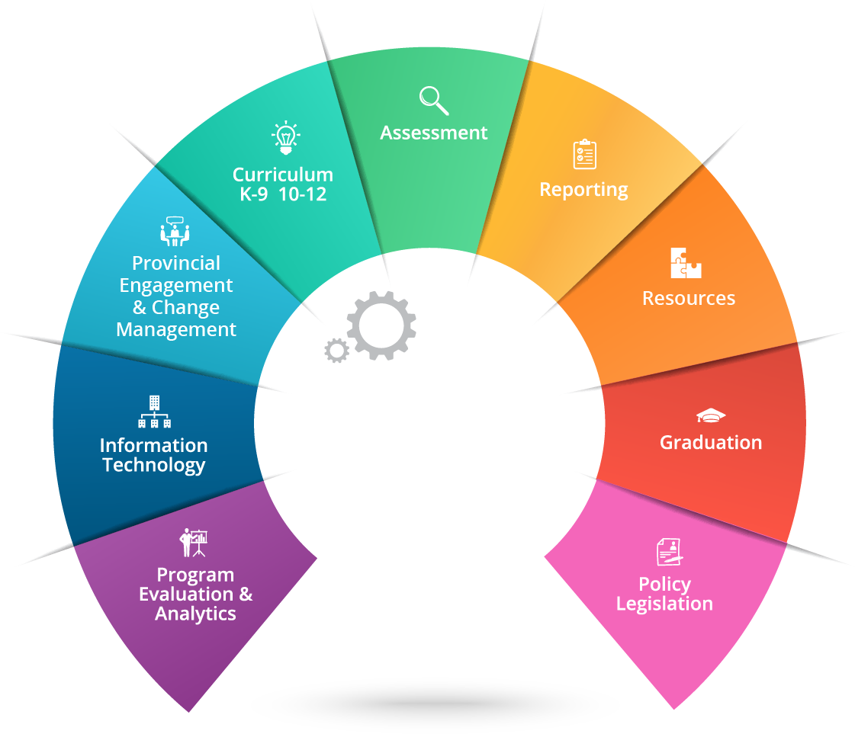
Scope

Slide 23

Implementation Schedule

Slide 24

Grade 11/12 Timeline Extended

Slide 25
Implementation Timing
The redesigned curriculum for Grades K-9 was mandated in the 2016/17 school year.
The new graduation program will begin full implementation July 2019.
Notes:
February 2, 2018
Implementation Support

Slide 26
Implementation Timing
This year’s Grade 12 students are the last students on the 2004 Graduation Program.
    Their graduation requirements have not changed
    They will complete the LA12 Provincial Exam

Slide 27
Implementation Timing
Students in Grades 10 and 11 in the 2017/18 school year – and beyond –
are on the new Graduation Program.

Slide 28

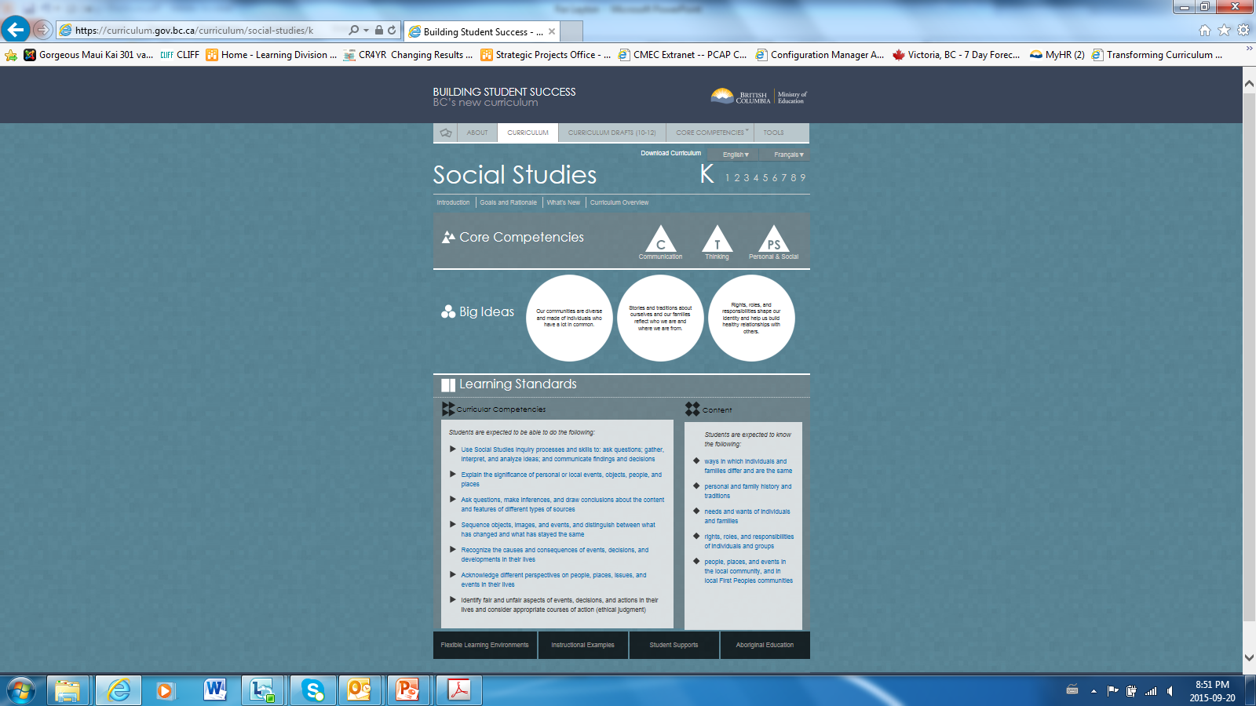

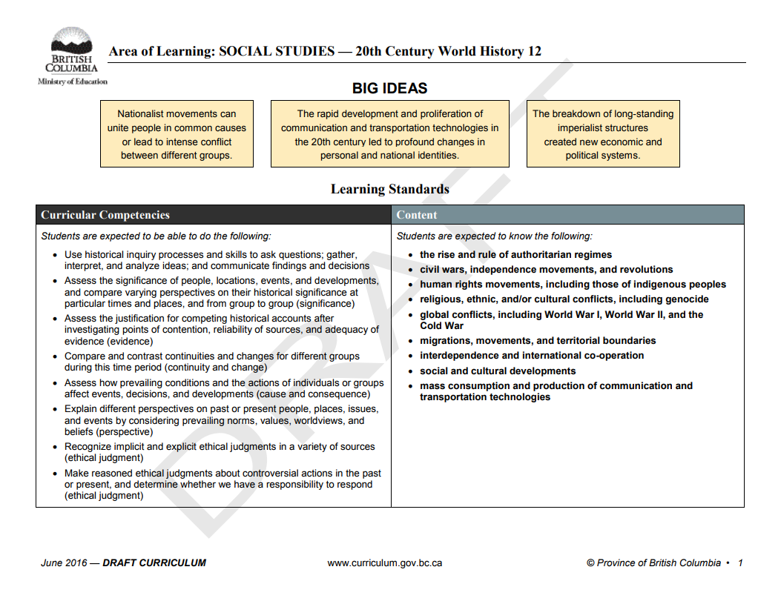
Curriculum - where we are at:
Finalize Grade 10 curriculum and post to website -April 2018
Finalize Grade 11-12 curriculum and post to website - June 2018
Grade 10 curriculum mandated - July 2018
Grade 11-12 curriculum mandated - July 2019

Slide 29
Implementation Timing
The redesigned Grade 10 curriculum will be delivered to all BC students in 2018/19, and the redesigned Grade 11 and 12 curriculum in 2019/20.
Notes:
February 2, 2018
Implementation Support

Slide 30
Implementation Timing
The draft Grades 10-12 curriculum has been available for review and feedback by stakeholders since 2016; feedback is being integrated into the final curriculum prior to full implementation.
Notes:
February 2, 2018
Implementation Support

Slide 31
Implementation Timing
The managed implementation of the Graduation Numeracy Assessment launched in January 2018 and the Graduation Literacy Assessment is planned for 2020.
Notes:
February 2, 2018
Implementation Support

Slide 32
What Has Changed

Slide 33
What Has Changed?
Curriculum has been redesigned to be more learner-focused, inquiry-based and flexible, with a focus on core competencies, Big Ideas and learning standards; Indigenous culture and perspectives have been integrated into all curriculum.
New Course Structures:
  8-credit Career Life Program with flexible delivery options and a Capstone Project
  Health Education has been combined with Physical Education
  Courses designed to be accessible to all students; Communications 11 & 12 discontinued
Notes:
February 2, 2018
Implementation Support

Slide 34
What Has Changed?
2. Two new Provincial Graduation Assessments:
    Numeracy Assessment and Literacy Assessment – aligned with the redesigned curriculum.
3. BAA Guidelines updated to align with the redesigned curriculum.
Notes:
February 2, 2018
Implementation Support

Slide 35
What is Staying the Same?
High standards still placed on core skills (numeracy & literacy)
Still require 80 credits to graduate (52 core credits and 28 elective credits) representing a breadth of subject areas
No changes to report cards, transcripts or scholarships
No changes to Independent Directed studies, External Credentials, Course Challenges, Dual Credit courses or Equivalency credits

Slide 36
WHAT IS NEW: Curriculum Structure
Focus on learner-centered and flexible learning.
    Focus on learner-centered and flexible learning. Personalized options enable students to participate in choosing course content. An inquiry-based, hands-on approach encourages students to take more personal responsibility for learning.
    Teachers have greater flexibility in creating learning environments that are relevant, engaging and novel, promoting local contexts and place-based learning.
Notes:
February 2, 2018
Implementation Support

Slide 37
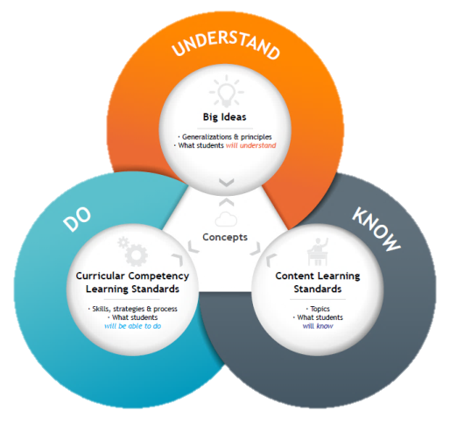
WHAT IS NEW: Curriculum Structure
Curriculum structure has 3 main components that work together to support deep learning, regardless of subject: Big Ideas, Content, Curricular Competencies.
        Big Ideas (what students will understand) – generalizations, principles, key concepts
        Content (what students will know) – essential topics and knowledge
        Curricular Competencies (what students will be able to do) – skills, strategies, processes

Slide 38
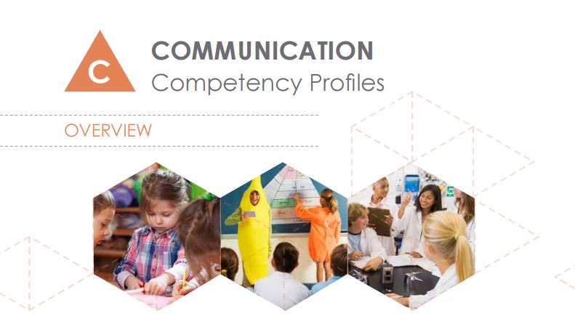
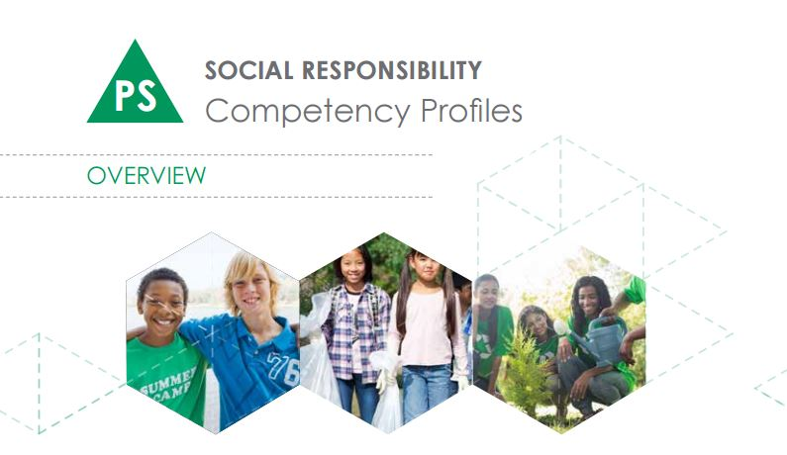
WHAT IS NEW: Curriculum Structure
Three core competencies embedded in all learning standards: Communication, Thinking, Personal and Social Competency
The competencies encompass the intellectual, personal and social skills students need to develop for success in life beyond school and to become educated citizens.
Competencies are embedded within the learning standards of all curriculum. They come into play when students are engaged in “doing” in any area of learning. Together, the literacy and numeracy foundations and core competencies contribute to the development of educated citizens.

Slide 39
WHAT IS NEW: Curriculum Structure
Courses are not designed to stream student into easier or more difficult pathways.
  All courses allow for differentiation of teaching methods and all students are able to access any course.

Slide 40
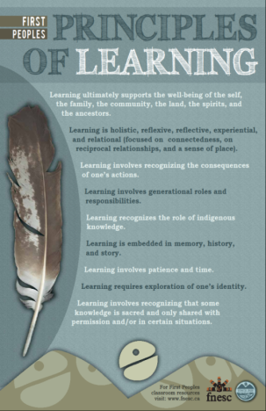
WHAT IS NEW: Curriculum Structure
Indigenous world views, perspectives and content built into all new and redesigned curricula (K-12).
    For example, place-based learning and emphasis on Indigenous ways of knowing reflect the First Peoples Principles of Learning in the curriculum.

Slide 41
WHAT IS NEW: Curriculum Structure
Literacy and numeracy skills developed through applications in all curricular areas.
    Renewed focus on reading, writing and math as core skills and their applications in the graduation years.

Slide 42
Course Structures
More course options in each subject area.
    These course options reflect a broad diversity and respond to emerging trends and student preference.

Slide 43
Opening Remarks
Graduation Program Requirements

Slide 44
What courses meet the new Graduation Program requirements?
Graduation requirements are maintained at 80 credits total, with a minimum of 16 at the Grade 12 level and 28 elective course credits. The 52 credits of required courses are:
  8 credits of Career Education
  Physical and Health Education (four credits)
  Science 10 (four credits), and a Science 11 or 12 (four credits)
  Social Studies 10 (four credits), and a Social Studies 11 or 12 (four credits)
  A Math 10 (four credits), and a Math 11 or 12 (four credits)
  A Language Arts 10, 11 & 12 (12 credits)
  An Arts Education 10, 11, or 12 and/or an Applied Design, Skills & Technologies 10, 11, or 12 (four credits)

Slide 45
Graduation Requirements
2004 Grad Program Grades 10-12 | 2018 Grad Program Grades 10-12
80 Credits Total* 52 Required Credits 28 Elective Credits | 80 Credits Total 52 Required Credits 28 Elective Credits
Language Arts 10, 11, 12 (4 credits each) | Language Arts 10, 11, 12 (4 credits each)
Mathematics 10 (4 credits) and a Mathematics 11 or 12 (4 credits) | Mathematics 10 (4 credits) and a Mathematics 11 or 12 (4 credits)
Science 10 (4 credits) and a Science 11 or 12 (4 credits) | Science 10 (4 credits) and a Science 11 or 12 (4 credits)
Social Studies 10 (4 credits) and a Social Studies 11 or 12 (4 credits) | Social Studies 10 (4 credits) and a Social Studies 11 or 12 (4 credits)
Fine Arts and/or Applied Skills 10, 11 or 12 (4 credits) | Arts Education and/or an Applied Design, Skills, and Technologies 10, 11 or 12 (4 credits)
Planning 10 (4 credits) and Graduation Transitions (4 credits) | Career Life Education (4 credits) and Career Life Connections and Capstone Project (4 credits)
Physical Education 10 (4 credits) | Physical and Health Education 10 (4 credits)
28 credits of electives | 28 credits of electives
Students must take 5 provincial exams at the Grades 10-12 level to graduate | Students must take two Provincial Assessments in Grades 10-12 to graduate

Slide 46
Curriculum: The Design

Slide 47
Guiding Principles
Reduce the prescriptive nature of curriculum
Allow for flexibility and choice for teachers and student
Respect inherent logic in disciplines while supporting interdisciplinary learning.
Enable teachers to be creative and innovative in their design of learning experiences
Align assessment and evaluation with the redesign of the curriculum

Slide 48
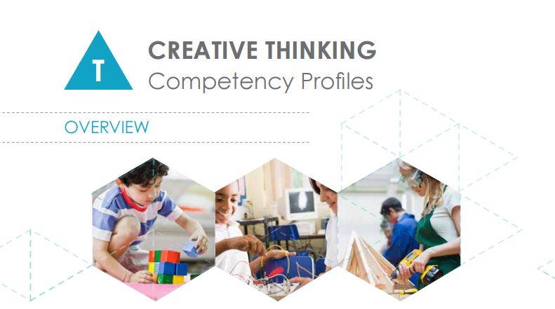
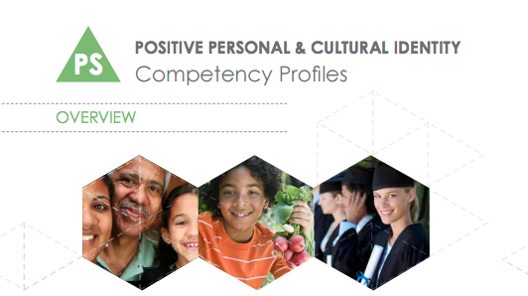
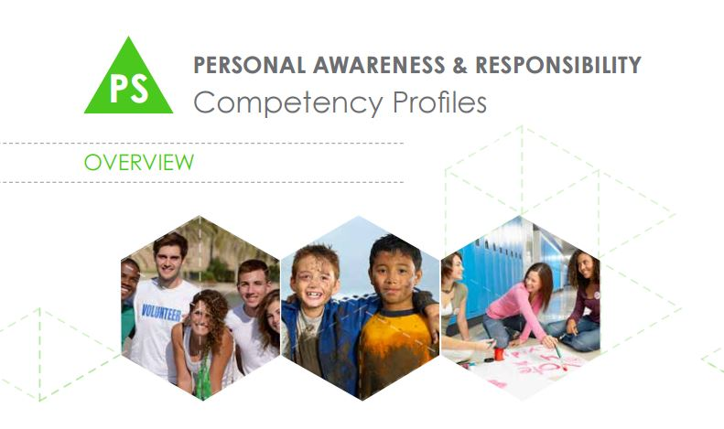
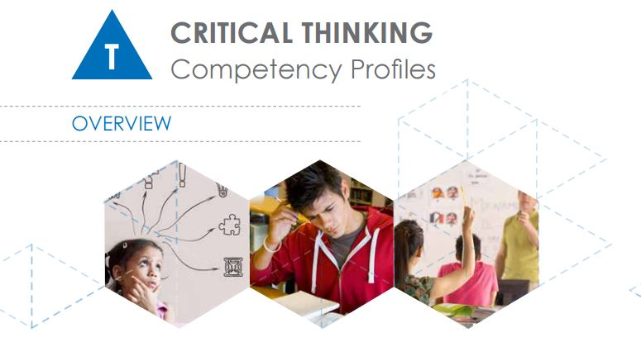

Slide 49
English Language Arts
Grade 10 4 credits | Grade 11 4 credits | Grade 12 4 credits
Choose two 2-credit options: Literary Studies Composition Spoken Language New Media Creative Writing | Choose one 4-credit option: Literary Studies Composition Spoken Language New Media Creative Writing | English Studies 12 – a 4-credit required course The following courses will also be offered as additional 4-credit elective options: Literary Studies Composition Spoken Language New Media Creative Writing
Webinar: https://curriculum.gov.bc.ca/sites/curriculum.gov.bc.ca/files/ELA_10-12_Curric_Structure_V2_Oct_2017.pptx
Notes:
EFP 10 and 11 have slightly different options.
English Studies 12 or English First Peoples 12 required.

Slide 50
English First Peoples
Grade 10 4 credits | Grade 11 4 credits | Grade 12 4 credits
Choose two 2-credit options: Writing Literary Studies New Media Spoken Language | Choose one 4-credit option: Literary Studies and Writing Literary Studies and New Media Literary Studies and Spoken Language | English 12 First Peoples 4-credit required course

Slide 51
Mathematics
Grade 10 | Grade 11/12
Foundations of Mathematics and Pre-calculus 10 Workplace Mathematics 10 | Computer Science 11 Foundations of Mathematics 11 History of Mathematics 11 Pre-calculus 11 Workplace Mathematics 11 Apprenticeship 12 Calculus 12 Computer Science 12 Foundations of Mathematics 12 Geometry 12 Pre-calculus 12 Statistics 12
Computer Science 11/12 now found here with math, not with Science courses
History of Math 11 new

Slide 52
Science
Grade 10 | Grade 11/12
Science 10 | Life Sciences 11 Chemistry 11 Earth Sciences 11 Environmental Science 11 Physics 11 Science for Citizens 11 | Anatomy and Physiology 12 Chemistry 12 Geology 12 Environmental Science 12 Physics 12 Specialized Science 12*
  *Created a flexible, specialty grade 12 course that allows for other course options (e.g., biochemistry, astronomy, kinesiology, etc.)
  Science for Citizens 11 is new and may be of interest

Slide 53
Social Studies
Grade 10 | Grade 11/12
Social Studies 10 | Explorations in Social Studies 11 Francophone History 11 20th Century World History 12 Asian Studies 12 B.C. First Peoples 12 Comparative Cultures 12 Comparative World Religions 12 Contemporary Indigenous Studies 12 | Economics 12 Genocide Studies 12 Human Geography 12 Law Studies 12 Philosophy 12 Political Studies 12 Physical Geography 12 Social Justice 12 Urban Studies 12
  Most courses designated as grade 12
  Explorations in Social Studies 11 course now posted
  Francophone History 11 course underway

Slide 54
Career Education
2018/19 | 2019/20
Career Life Education Planning 10 no longer offered | Career Life Connections (includes Capstone) GT no longer offered
Progress will be “graded”
RM not to be used

Slide 55
Arts Education
  58 courses posted online in Dance, Drama, Music & Visual Arts
  New courses:
      Photography 10, 11, 12
      Musical Theatre 10, 11, 12
      Dance Company 10, 11, 12
      Theatre Company 10, 11, 12
      Contemporary Music 10, 11, 12
    Focus on creative and artistic processes, discipline-specific language

Slide 56
Arts Education Grade 10-12 Course List
Dance | Drama | Music | Visual Arts
Dance Foundations 10 | Drama 10 | Choral Music 10 | Art Studio 10
Dance Choreography 10 | Theatre Production 10 | Instrumental Music 10 | Sculpture 10
Dance Company 10 | Theatre Company 10 | Contemporary Music 10 | Drawing & Painting 10
Dance Technique & Performance 10 | Drama 11 | Choral Music 11 | Photography 10
Dance Foundations 11 | Theatre Production 11 | Instrumental Music 11 | Art Studio 11
Dance Choreography 11 | Theatre Company 11 | Contemporary Music 11 | Sculpture 11
Dance Company 11 | Film & Television 11 | Composition & Production 11 | Drawing & Painting 11
Dance Conditioning 11 | Directing & Scriptwriting11 | Choral Music 12 | Photography 11
Dance Technique & Performance 11 | Drama 12 | Instrumental Music 12 | Graphic Arts 11
Dance Foundations 12 | Theatre Production 12 | Contemporary Music 12 | Art Studio 12
Dance Choreography 12 | Theatre Company 12 | Composition & Production 12 | Sculpture 12
Dance Company 12 | Film and Television 12 |  | Drawing & Painting 12
Dance Conditioning 12 | Directing & Scriptwriting 12 |  | Photography 12
Dance Technique & Performance 12 |  |  | Graphic Arts 12
Media Arts 10, 11, 12 Musical Theatre 10, 11, 12

Slide 57
Applied Design, Skills and Technologies -ADST
  56 courses posted online
  Grades 10-12 course options in Business Ed, Culinary Arts, Home Economics, ICT, Media, and Tech Ed
  Grades 11-12 course options in Tourism
Notes:
Applied Design, Skills and Technologies

Slide 58
Second Languages
  Core French, Punjabi, Spanish, German, Japanese, Mandarin Chinese, American Sign Language, Italian, Korean
  Introductory 11 is being created for all second languages
  Second language template is under redesign

Slide 59

The Guide
https://curriculum.gov.bc.ca/tools

Slide 60
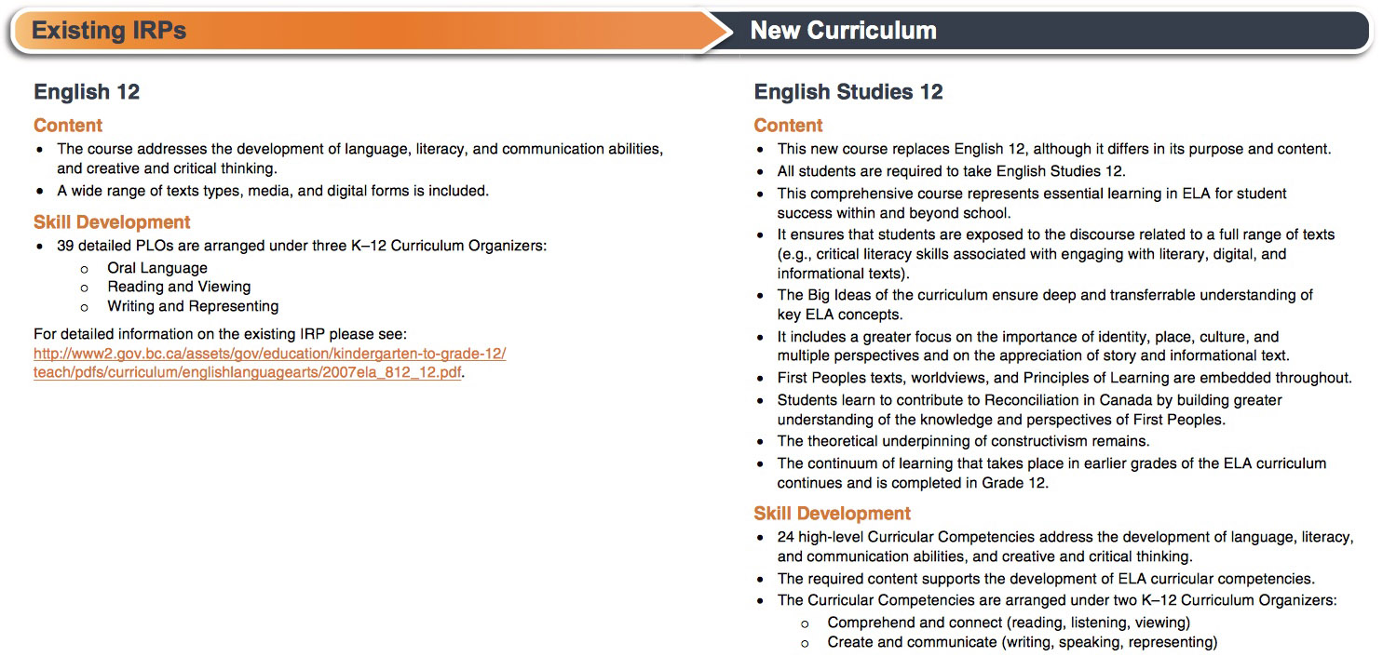
Inside the Guide
https://curriculum.gov.bc.ca/tools

Slide 61

Assessment and Reporting

Slide 62

Student Progress Reporting
No planned changes to the Grades 10-12 reporting policy for 2018/19 or 2019/20.
Letter grades and percentages continue to appear on formal report cards and transcripts for all courses completed.

Slide 63

Provincial Assessments
CURRENT THINKING

Slide 64


Purpose
Serves as a graduation requirement
Provides students with evidence of their proficiency in numeracy and literacy for use after graduation
Provides system-level performance information in the areas of literacy and numeracy

Slide 65
Comparing the Old and New Provincial Assessments
What is the Same?
developed by practicing BC educators
required for graduation
written in 2 hours (plus an additional hour if needed)
marked centrally (as were LA12 exams)
based on high standards and rigour (employing the same statistical methodologies)
What is New?
not tied to a course (cross-curricular)
include student choice
administered on-line except for two paper-based problem solving questions in Numeracy
present a variety of engaging question formats
include student self-reflection
administered over a week-long window
reported on a proficiency scale
Students will be given up to three opportunities to complete the assessment.

Slide 66
Comparing the Old and New Provincial Assessments
What is the Same?
developed by practicing BC educators
required for graduation
written in 2 hours (plus an additional hour if needed)
marked centrally (as were LA12 exams)
based on high standards and rigour (employing the same statistical methodologies)
What is New?
not tied to a course (cross-curricular)
include student choice
administered on-line except for two paper-based problem solving questions in Numeracy
present a variety of engaging question formats
include student self-reflection
administered over a week-long window
reported on a proficiency scale
Students will be given up to three opportunities to complete the assessment.

Slide 67

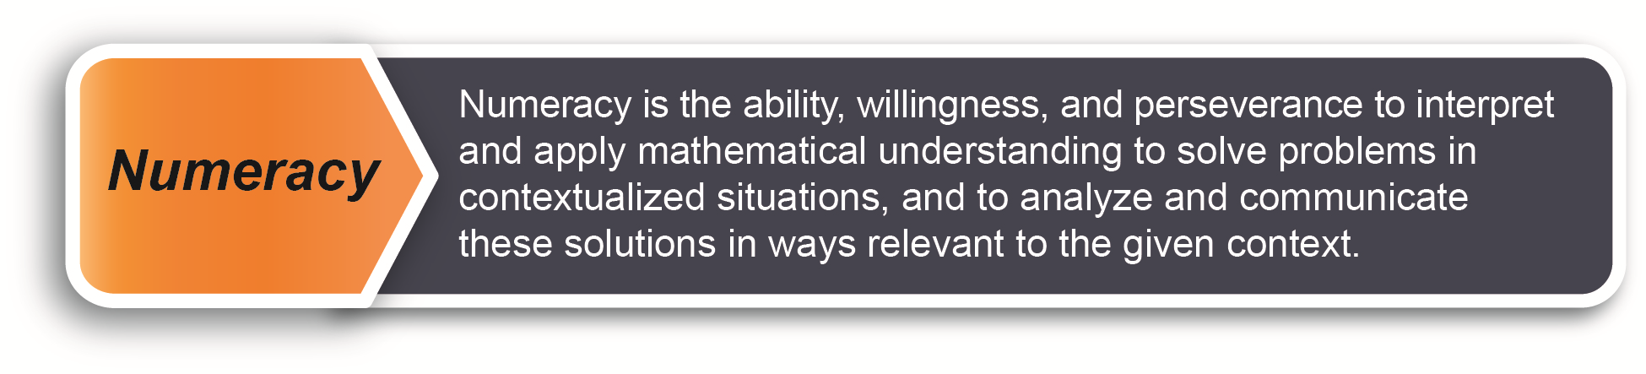
Numeracy Assessment

Slide 68
Numeracy Overview
Not linked to specific Mathematics course and will be reported on a four-category proficiency scale.
Students who entered Grades 10 and 11 in 2017/18 are in the new Graduation Program
  Numeracy assessment is a graduation requirement and is written during the graduation years (10-12)
  Three attempts allowed
  Final transcript will display best outcome

Slide 69
Numeracy administration-where we are at:
January 2018: managed implementation of 1st numeracy administration – over 9000 students wrote the assessment
June 2018: full administration of numeracy assessment

Slide 70
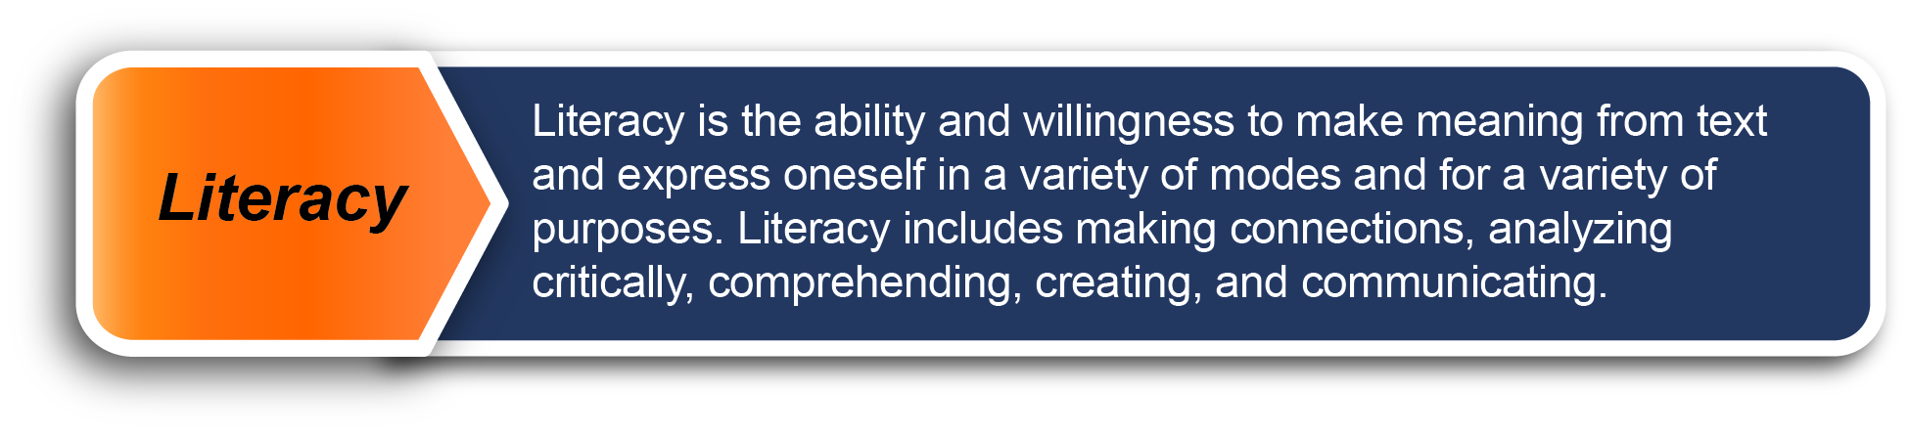
Literacy Assessment

Slide 71
Literacy administration: tentative next steps
Fall 2018
      Field testing
Winter 2018
      Draft specifications available online
Winter 2019
      Final specifications, exemplars and samples available online
Fall 2019
      First administration of literacy assessment

Slide 72
Summary
Students in Grade 10 in 2017/18 will:
Follow the 2018 Graduation Program requirements
Write the Numeracy and Literacy Assessments before graduation (the Literacy Assessment is being introduced in 2019/20)

Slide 73
Summary
Students in Grade 11 in 2017/18 will:
  Follow the 2018 Graduation Program requirements
  Write the Numeracy Assessment before graduation
  Take a Language Arts 12 course and write the associated provincial exam.

Slide 74
Summary
  Students in Grade 12 in 2017/18 will:
    Finish all the 2004 Graduation Program requirements
    Have completed a Math 10, a Language Arts 10, a Science 10 and have written associated provincial exams
    Take a Language Arts 12 course and write the associated provincial exam
    Not write the new Numeracy or Literacy Assessments

Slide 75
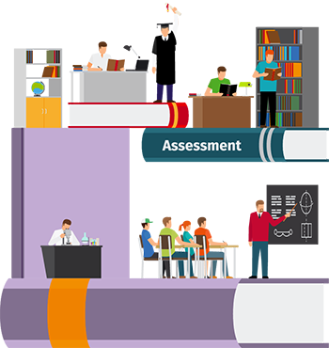

Reporting Graduation Assessment Results
CURRENT THINKING

Slide 76
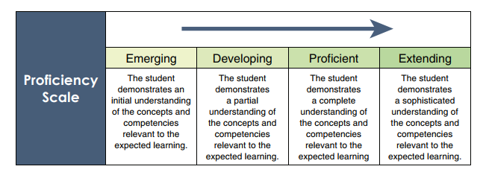
Proficiency Scale
A proficiency category such as the following will be implemented to report overall performance on both the Numeracy and Literacy assessment.
It will be descriptive in nature and will indicate what skills the student has demonstrated to attain that level.
The proficiency category will be recorded on the transcript.

Slide 77
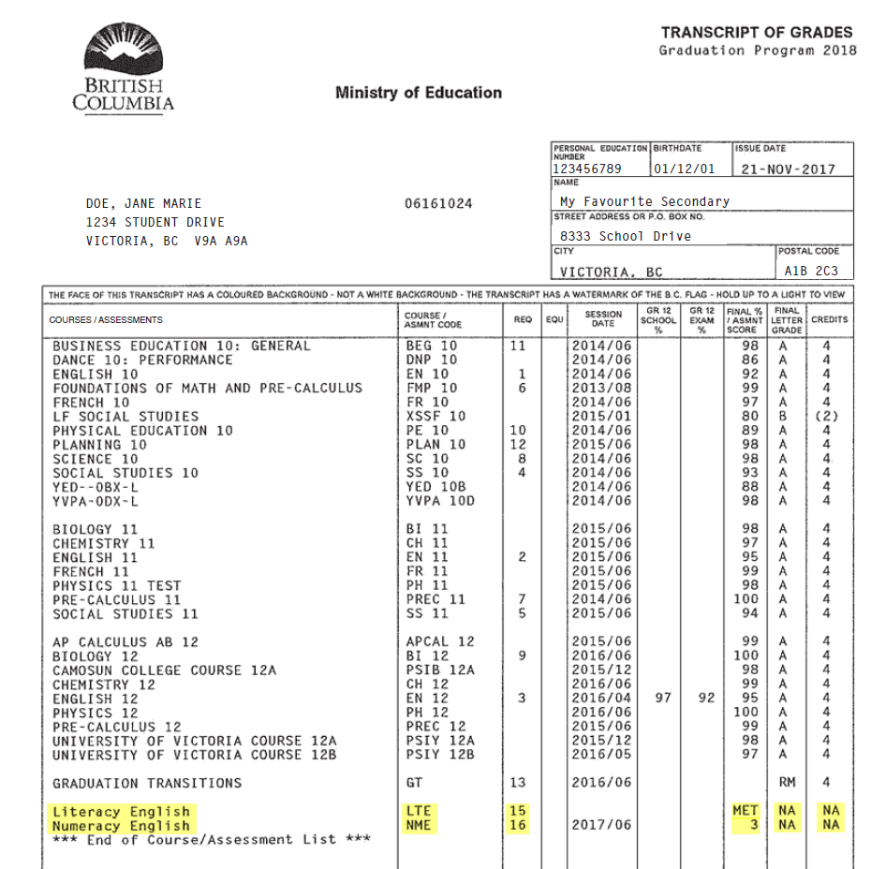
Transcript

Slide 78
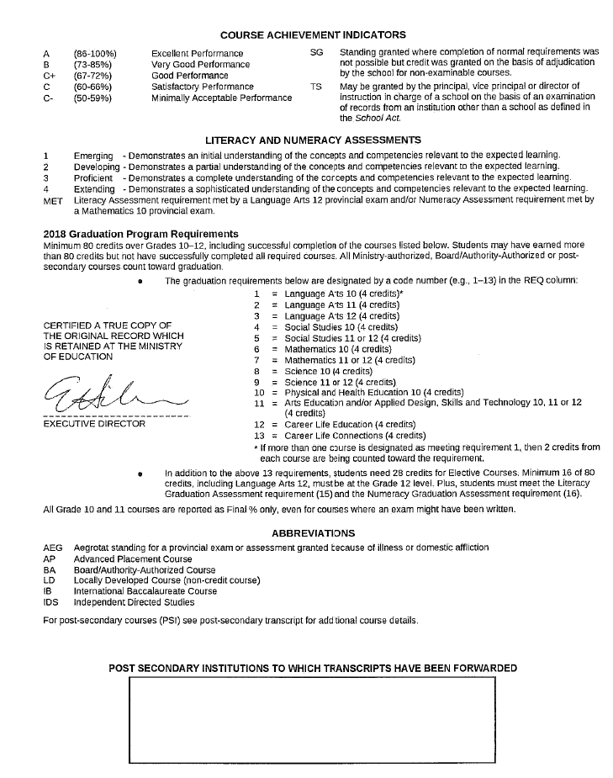

Slide 79
Emerging -Demonstrates an initial understanding of the concepts and competencies relevant to the expected learning.
Developing -Demonstrates a partial understanding of the concepts and competencies relevant to the expected learning.
Proficient -Demonstrates a complete understanding of the concepts and competencies relevant to the expected learning.
Extending -Demonstrates a sophisticated understanding of the concepts and competencies relevant to the expected learning.
MET Literacy assessment requirement met by a Language Arts 12 provincial exam and/or Numeracy Assessment requirement met by a Mathematics 10 provincial exam.

Slide 80
Opening Remarks
Career Life Curriculum

Slide 81

What is a Career?
The word “career” comes form the Latin for cart or chariot (carrus)
- a means to carry you from one point to another.
A career is about the life one want to lead
– not just a job, occupation or profession.
It involves deciding among possible and preferred futures.
It answers:
“Who do I want to be in the world?,”
“What kind of lifestyle am I seeking?”
and
“How can I make an impact?”

Slide 82
Career Life Program
The biggest change to course requirements for students on the new Graduation Program involves the retirement of two career courses (Planning 10 and Graduation Transitions), and the introduction of 8 credits in Career Education:
          Career Life Education
          Career Life Connections with Capstone

Slide 83
Career Life Program
Together these “courses” form 8 credits.
    The intention is for schools to be flexible with delivery and not necessarily to see them only as two 4-credit courses, but rather 8 credits to be achieved during the student’s graduation years (10-12).

Slide 84
Career Life Program
Career education courses that will be used in all BC schools in 2018/19:
        Career Life Education
        Graduation Transitions
Career Life courses that will be used in all BC schools in 2019/20:
        Career Life Education
        Career Life Connections with Capstone

Slide 85

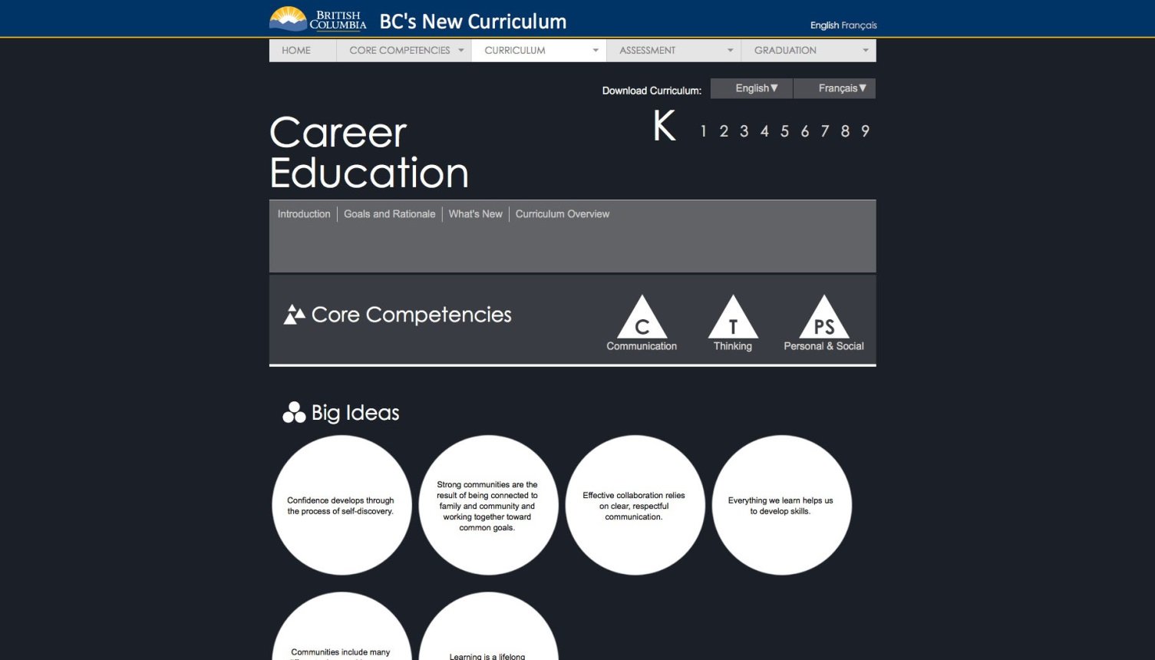
Notes:
We are hoping that this development of student’s “picture of themselves” and self reflection of their learning and their passions begin early
We know “that this will look different by age but if we keep in mind the new definition of career, we can imagine what this kind of adult support could look like over a students educational journey
Definitely a place for the core competency development to be overt and obvious
Definitely a place for kids to build their profiles of learning over time

Slide 86


Dynamic Portfolio/Profiles of Learning
Document, sort and represent one's emerging sense of self
Learn to gather evidence of competencies;
Learn to document stories and provide representations of learning;
A true "curriculum vitae"
Notes:
So assisting students in creating something that can land as a true curriculum vitae that is built over time and has value in their post graduation world both with employers and with post secondary
We are currently working with some post secs to see where and how this portfolio that represents who a student is and what they can do could be valued as part of an entrance criteria
We are also working with employers to determine how this can be part of “getting selected” for career opportunities as more and more of them are saying we need to see “who these students are, what they are capable of, and how can we see authentic evidence to show us they are equipped with the core competencies needed to be successful
Google, Amazon etc are all saying things like: “I don’t care what your transcript says”…. “show me who you are and what you can do”

Slide 87

Current Thinking for Capstone
Notes:
So how can this profile of learning development help shape a students capstone
How can we allow for several capstone opportunities along the k-12 journey so that it is not just a one time thing in graduation
Providing opportunities along the student’s journey to go deep in their learning about something they are passionate about or to “tell their story” cant help but support their journey towards becoming an educated citizen

Slide 88
Capstone
Create a personal integrated plan for post-graduation that articulates choices related to (but not limited to):
  Career
  Education
  Personal Passions
  Finances- Health and Well-being
Design, assemble, and present a capstone project to an audience that demonstrates reflection on personal learning and achievement (in and out of school), growth in the core competencies, and reflection on a post-graduation plan.
Notes:
Reflection of personal learning and growth both in and out of school
Pulled together in a project as a self-reflection demonstration that does not have to look all one way
We want to begin to show the Connections of this capstone project to post-secondary and world of work where the next adventure requires one to be self reflective of their learning almost above all else. We are in a world where success first and foremost will depend on one’s ability to learn, not on one’s accumulation of knowledge. Where learning “IS” the work. In working with post sec and employers, this is one of the major skill sets that they are saying will determine success.

Slide 89
What is Happening at Post Secondary?

Slide 90
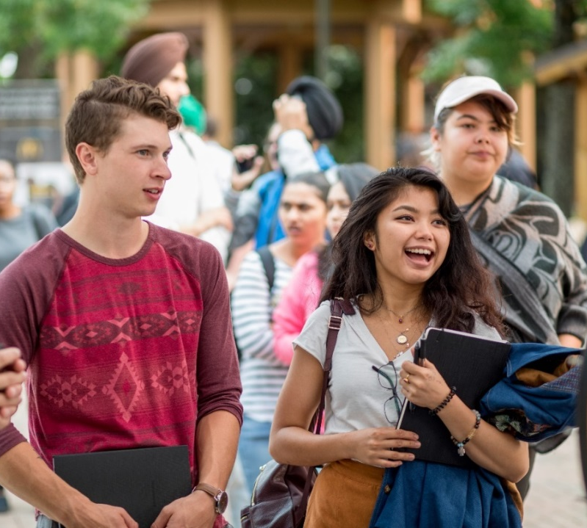
Graduation Requirements and Post-Secondary
What has the Ministry heard from Post Secondary?
Ministry staff continue to support PSIs as they work through their review and governance processes to ensure alignment with the changes in the K-12 sector.
This includes their consideration of the Numeracy and Literacy Assessments.
Numeracy and Literacy assessments likely used as value add; UBC and SFU have indicated the Numeracy Assessment results will not be considered as part of student admission.
Anticipate PSIs to post admission requirements by early Fall 2018
    UBC and SFU admission requirements:
UBC Admission Requirements
SFU Admission Requirements

Slide 91
Engagement with Post Secondary Institutions
Working jointly with the Ministry of Advanced Education and Skills Training to engage with Post Secondary Institutions (Association Presidents, Vice Presidents, Registrars and Faculty)

Slide 92
Engagement with Post Secondary Institutions
Primary areas of interests include:
Implementation Schedule: Alignment between sector timelines and PSI’s review and approval process
10-12 curriculum: ELA 11 & 12, Math, Science & Socials Studies are of most interest
Graduation Assessments: Interested in how the results will be recorded on the transcripts
Teaching and Learning for Faculty: Interested in how PSIs prepare for a different type of learner

Slide 93
Opening Remarks
Key Resources & Support

Slide 94
Key Resources and Support
    BC Curriculum Comparison Guides
    Provincial Assessments
    Educator Updates
    Graduation Pathway
    Graduation
* Please visit Curriculum website often, materials updated regularly
Notes:
Resources and supports are regularly updated, continue to visit the MoE website

Slide 95
Key Resources and Support
    https://curriculum.gov.bc.ca/tools
Notes:
Resources and supports are regularly updated, continue to visit the MoE website

Slide 96
Grad Program Webinars (in conjunction with the BCPVPA)
Date | Topic | Speaker
Tuesday September 26 – 7:30 a.m. | Foundation Skills Assessment Update | Janet Powell, Acting Director, Provincial National and International Assessment Nancy Walt, Executive Director, Curriculum and Assessment
Thursday September 28 – 4:00 p.m. | Social Studies Update | Nick Poeschek, Social Studies Coordinator Brent Munro, Director, Curriculum
Tuesday October 3 – 7:30 a.m. | Career Education Update | Jan Unwin, Superintendent of Graduation and Student Transitions Angie Calleberg, Acting Director, Classroom Assessment Nicole Arklie, Career Education Coordinator
Thursday October 5 – 4:00 p.m. | Classroom Assessment Update | Angie Calleberg, Acting Director, Classroom Assessment Nancy Walt, Executive Director, Curriculum and Assessment
Thursday October 12 – 4:00 p.m. | Math and Science Update | Angie Calleberg, Acting Director of Classroom Assessment Nicole Arklie, Mathematics Coordinator
Tuesday October 17 – 7:30 a.m. | Arts Education Update | Melanie Bradford, Arts Education Coordinator
Thursday October 19 – 4:00 p.m. | Provincial Graduation Assessments Update | Markus Baer, Director, Graduation Assessments Nancy Walt, Executive Director, Curriculum and Assessment
96

Slide 97
Nancy Walt
Executive director, curriculum and assessment
Emilie Hillier
Executive director, services and technology

Slide 98
B.C. GRADUATION PROGRAM
IMPLEMENTATION SURVEY
https://feedback.engage.gov.bc.ca/144689?lang=en

Slide 99
Questions
Pat.Duncan@gov.bc.ca

