Slide 1
DISTRICT AUTHORITY SCHOLARSHIP
Independent Schools
2024-2025
Info Session Feb. 20, 2025

Slide 2
BC Provincial
Scholarship Program
Pathway to
Teacher Education
District Authority
Scholarship
BC Excellence
BC Achievement
55 Awards
$5,000
Ministry Adjudication
1 Nominee per school
20 Awards
$5,000
Ministry Adjudication
8,000 Awards
$1,250
Percentage grade
5,500 Awards
$1,250
Public District / FISA
Adjudication

Slide 3
Provincial Scholarship Student Eligibility Requirements
Must be a Canadian citizen or
permanent resident (landed immigrant)
Be a B.C. resident
Enrolled in a Public School or a
Group 1, 2, or 4 Independent School
Complete all graduation requirements, and be on record as having graduated, by Aug. 31, 2025

Slide 4
397 DAS
Independent School Sector 2024-2025
1 DAS per every 14 Students
BC Resident Full-Time Equivalent

Slide 5
Adjudication
Previous
New
4 Regional Zones
Proportional Distribution to Schools
Competition Pools of 1,100 - 2,700 students
Application, Portfolio/Interview, References
Cadre of Adjudicators
Schools establish DAS selection process
Intra school competition pool
School selection committee
OUTCOME
20% of schools fared exceptionally well
23% of schools matched proportional
57% of schools have never had a DAS recipient
OUTCOME
73% of schools have confirmed participation
20% of schools no response yet (due Feb. 24)
7% of schools have declined

Slide 6
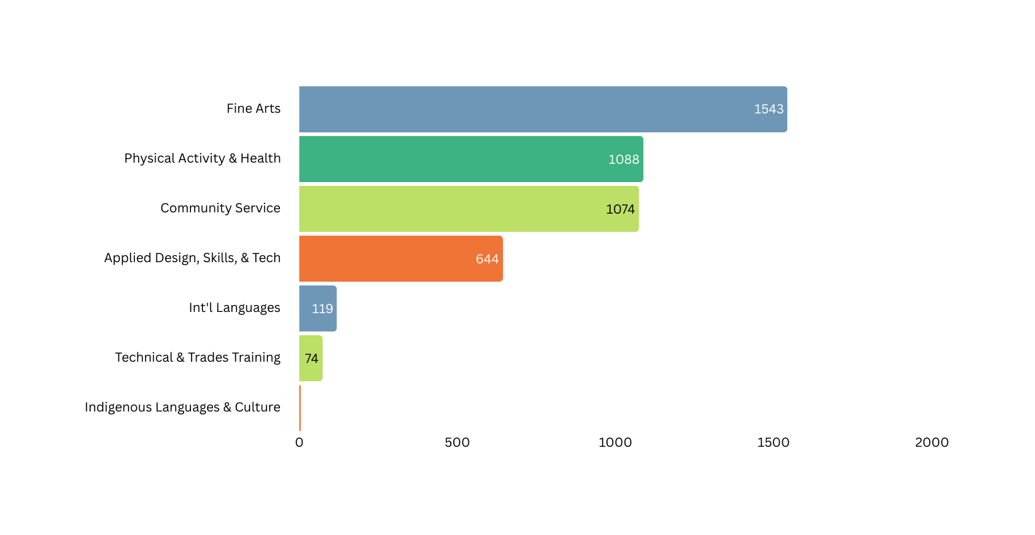
Ministry Categories
FISA Distribution 10 Years
Indigenous
Languages
& Culture
Fine Arts
Technical &
Trades Training
DAS Categories
Physical Activity
& Health
International Languages
Community Service
Applied Design,
Skills, &
Technologies
5
Schools may choose to prioritize certain categories when distributing their DAS.

Slide 7
School-based
Application Process
Applications must include
a. A listing of course work and extracurricular activities related to their area of interest
b. A personal statement that describes their achievements.
School authorities may choose to include additional requirements such as:
a. Submission of a project/portfolio (electronic or hard copy), display, or video.
b. Participation in an interview, performance, or demonstration.
c. Submission of reference letters

Slide 8
School-based
Application Process
Application Template will be provided to participating schools

Slide 9
Timeline
Feb. 24th
Feb. 28th
March - April
May 7th
May 20th
FISA will
send sample application
Schools invite students to apply for a DAS and establish a
Schools to submit their list of conditional winners to FISA.
FISA will confirm conditional winners with schools and
Last chance to confirm participation
and link to
submit
conditional winners.
a selection committee to choose their conditional winners.
provide instructions on how to redeem vouchers.
Schools communicate with to students, staff, and parents.
Schools communiate with FISA.
FISA communicates with the Ministry.

Slide 10
Questions? Contact info@fisabc.ca

